Slide 1
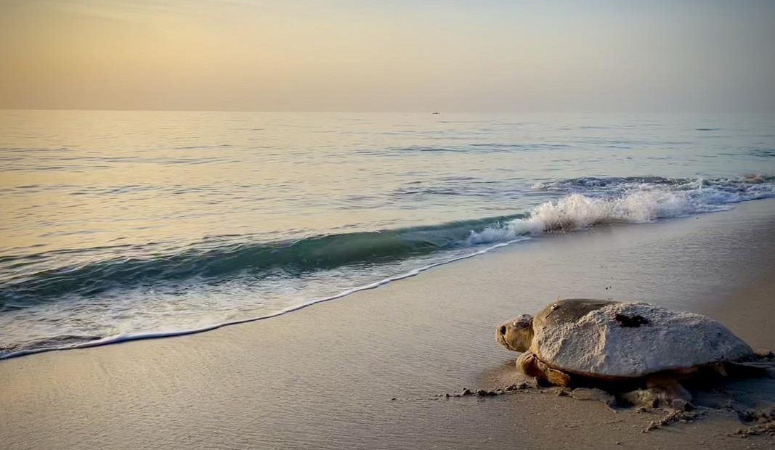
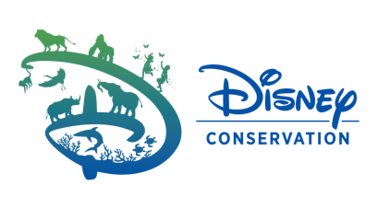
Behavior Change Campaigns for Sea Turtle Conservation
Disney Conservation: Rachel Smith and Kelley Anderson
Oceanic Society/SWOT: Roderic Mast, Brian Hutchinson,
Ashleigh Bandimere, and Lindsay Mosher

Slide 2
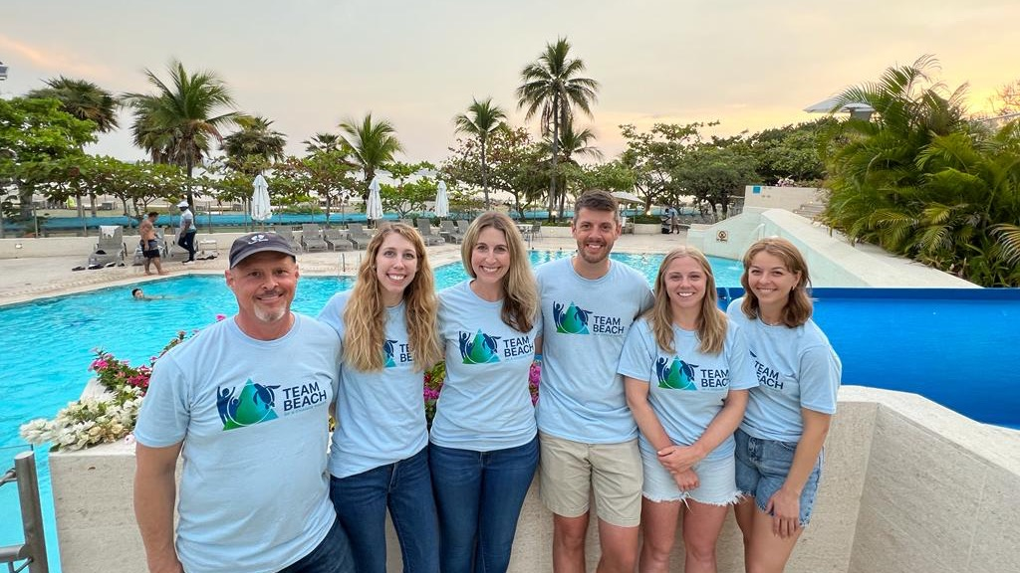
Team BEACH Introductions

Slide 3
Agenda for the workshop
Background on behavior change in conservation
9:00 am
Successes and learnings
Meet the 5 case studies
Breakout sessions
Group presentations and discussion
Adjourn
1:00 pm
Notes:
Interactive poll: How much do you currently know about creating behavior change campaigns?

Slide 4
Goals for the workshop
Learn about the process of designing a behavior change strategy or campaign for conservation.
Develop a behavior change strategy and provide suggestions for the submitted case studies.
Notes:
Evaluation isn't on here. Focusing on the design here.
Not going to solve these problems in our session. Provide suggestions to the case study submitters. How can they think about this differently? What could they do?

Slide 5
Conservation is about PEOPLE
Notes:
Conservation requires action (most threats caused by people- requires actions by people to reduce threats)
Interactive: What are the most pressing threats to sea turtle populations? (open-ended). Follow-up verbal question: which of these were not created by humans?

Slide 6
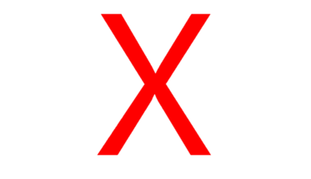
When human behavior isn’t addressed…
Awareness
Assumptions
Notes:
Add red X to indicate this is not what we want

Slide 7
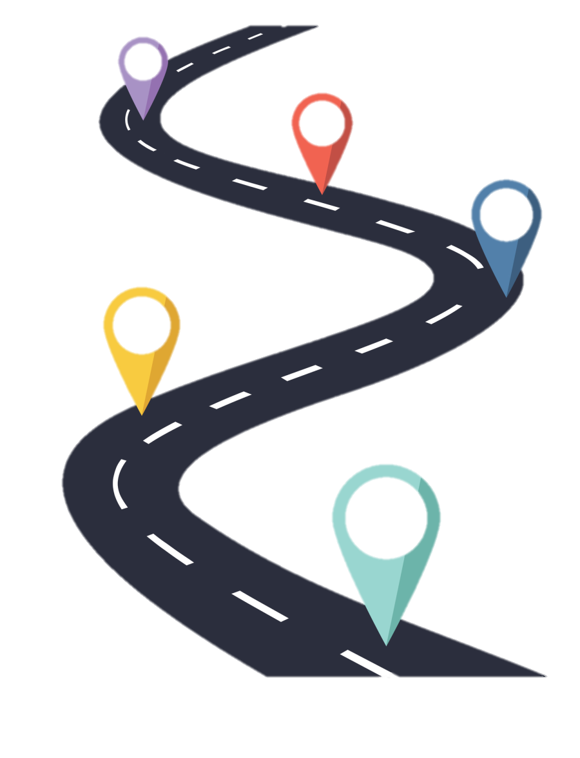
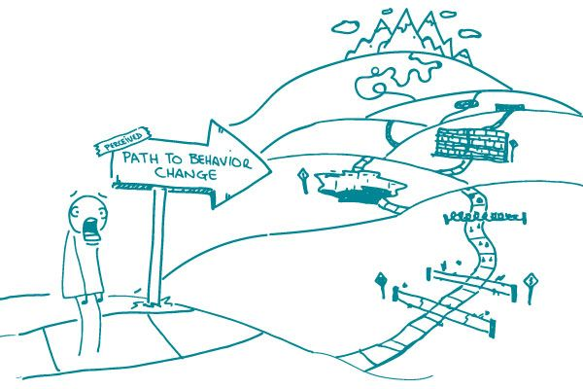
Behavior Change Theory
Notes:
What is theory and how is it useful in applied contexts?
Examples, built on formulas, understanding your contributing variables. Like math!

Slide 8
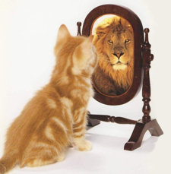
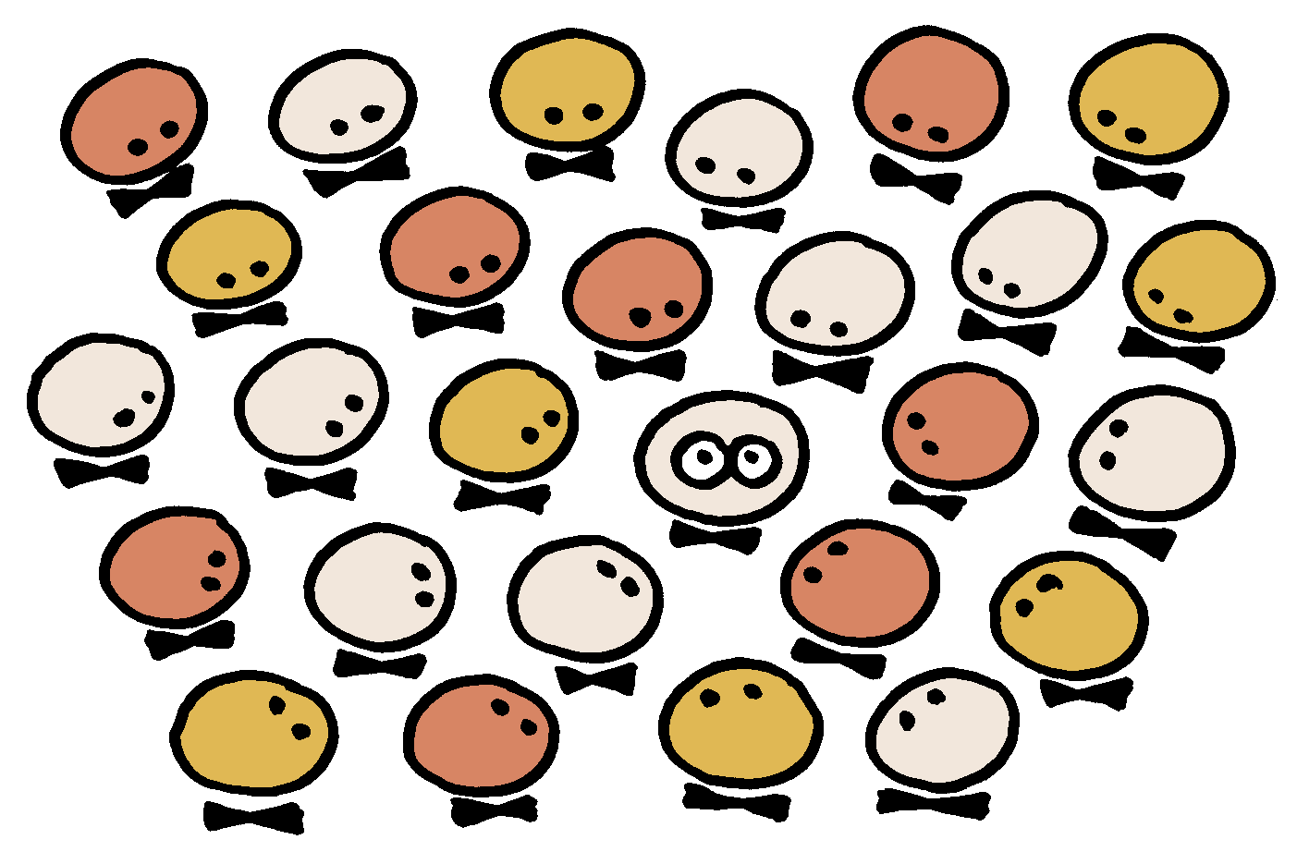
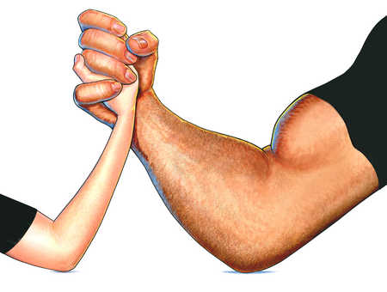
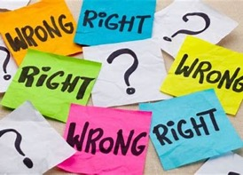
Introduction to Behavior Change Theory
Attitudes
Self-efficacy
Social Norms
Values
Perceived Control
Personal
Norms
Beliefs
Actual
Control
Notes:
Introduce common concepts/constructs. Touch on identity.
Interactive poll: Which behavior change concept resonates most with you?

Slide 9
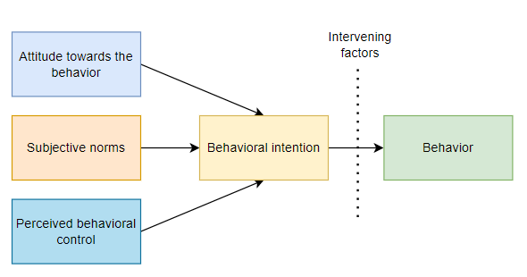
Theory of Planned Behavior
Is it worth it?
Do others think I should do it?
Do I think I can do it?

Slide 10
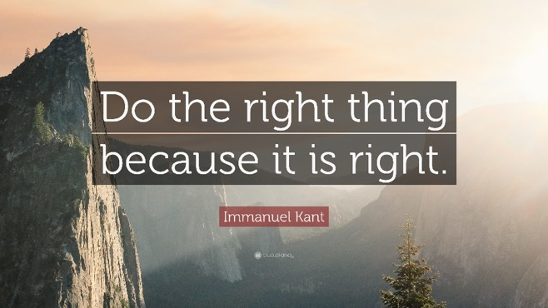
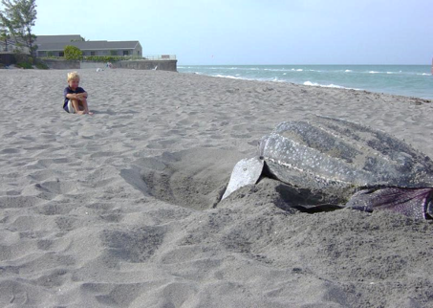
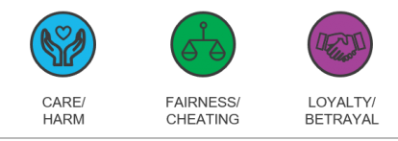
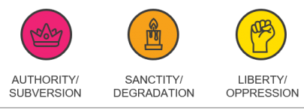
Value-Belief-Norm Theory
Moral Foundations
Notes:
Use distance/not disturb nesting turtles example. Touch on identity here.

Slide 11
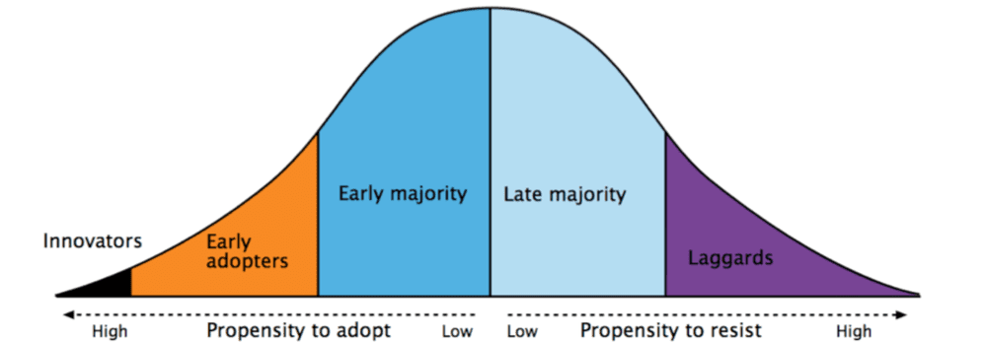
Diffusion of Innovation Theory
Relative advantage
Compatibility
Complexity
Trialability
Observability
Opinion leaders
Change agents
Aides
Notes:
Practical examples of modeling diffusion, or adoptability, of innovations exist across all fields: in conservation, paper straws is a great example. Also think of smart phones, vaccines, electric cars, and use of social media.
While mass media gets the most attention, personal channels tend to have the most success in changing behavior.
Diffusion of Innovation model
Five characteristics of an innovation/intervention/behavior likely to be adopted
Thinking about stakeholders and “your team” in terms of opinion leaders, change agents, and aides. Also think about who your early adopters are likely to be.

Slide 12
Steps to create a behavior change strategy
Identify the threat or challenge
Identify behaviors to help mitigate the threat
What?
Identify your target audience
What do you know and not know about your target audience? What assumptions are you making?
Stakeholder analysis- who do you need on your team to successfully change this behavior?
Who?
Identify motivations for current behavior
Identify barriers to adopting the desired behavior
Why?
Identify potential theories/frameworks to help guide your strategy
Determine your key message and how you will frame it
Determine mode of delivery to best reach your audience and key spokespeople
How?
Consult the Team BEACH network when thinking through future campaigns!
Notes:
Not super linear- may need to jump around

Slide 13
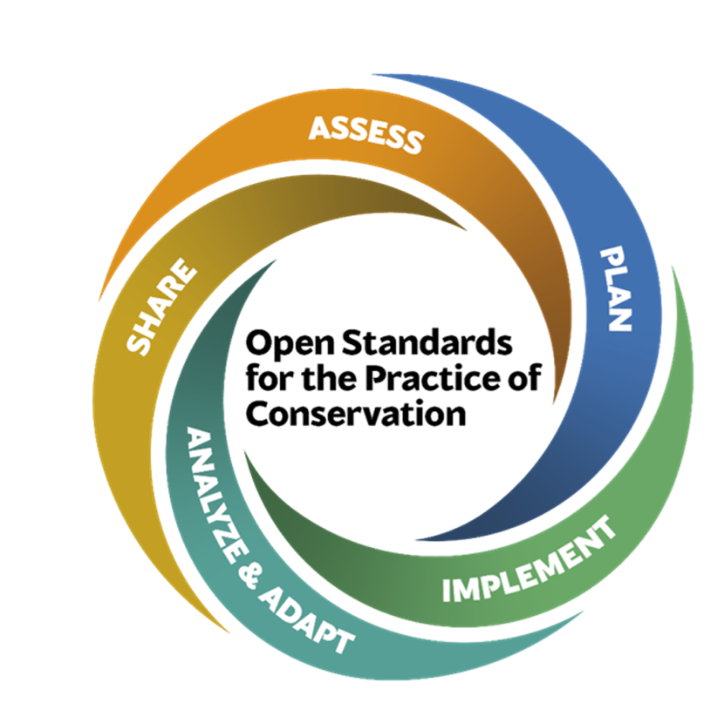
Evaluation & Adaptive Management
Assess
Critical threats to be addressed
Background information
Purpose and scope of project
Plan
Goals, objectives, and strategies
Program, project, operations
Monitoring and evaluation
Monitoring:
Operational progress against timeline
Evaluation:
Outcomes measurement
Survey, interviews, focus groups, observations
Share
Document and share learnings
Promote adaptive culture
Implement
Program, project, operations
Monitoring and evaluation
Analyze & Adapt
Analyze and interpret data
Adapt plan accordingly
Notes:
Tools
Think about this during program design
Determine 2-3 SMART metrics to evaluate the success of your initiative
Interactive poll: Do you currently formally evaluate your conservation education and outreach programs?

Slide 14
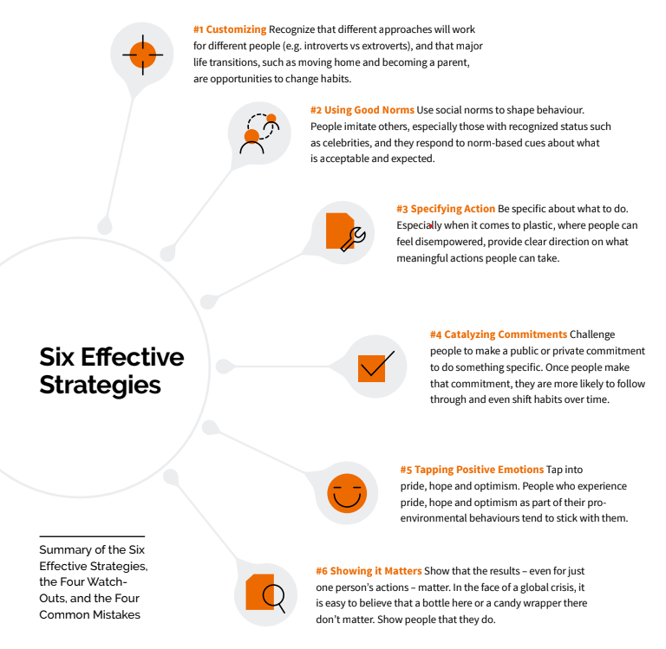
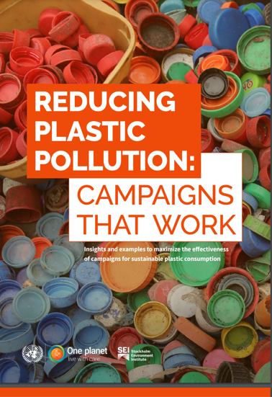
Effective strategies for behavior change

Slide 15
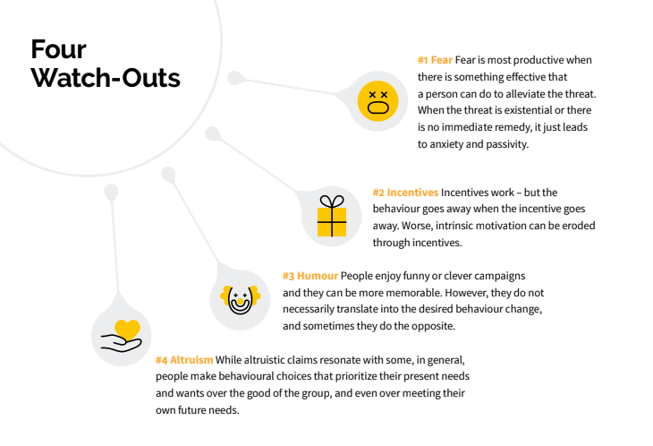
Watch-Outs!

Slide 16
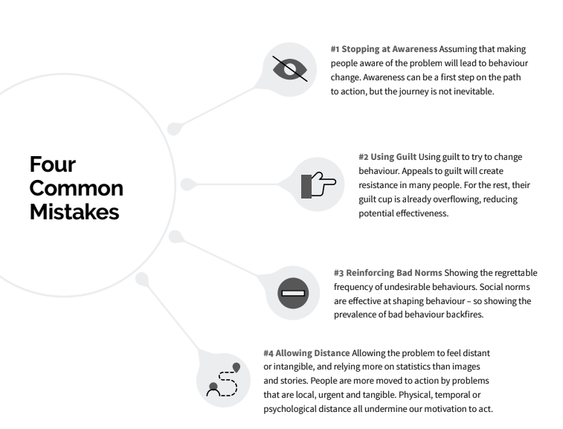
Common mistakes
Notes:
At the end…”Now let’s look at some real-life examples to see if we see any of these effective strategies, and common mistakes, show up in marketing campaigns”

Slide 17
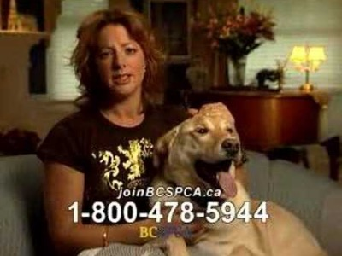
Campaign Examples: SPCA
Notes:
Examples.
Ask these questions: What was their strategy? Where did they use the 'dos'? Where did they fall victim to the 'don'ts'?

Slide 18
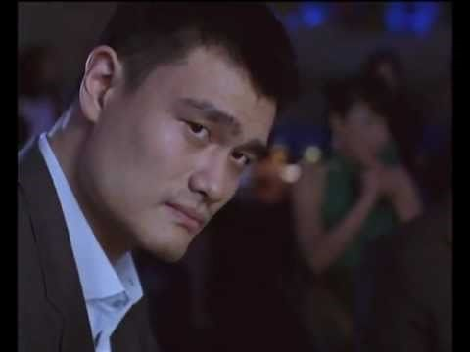
Campaign Examples: Wild Aid
Notes:
Examples.
Ask these questions: What was their strategy? Where did they use the 'dos'? Where did they fall victim to the 'don'ts'?
Sharks - WildAid

Slide 19
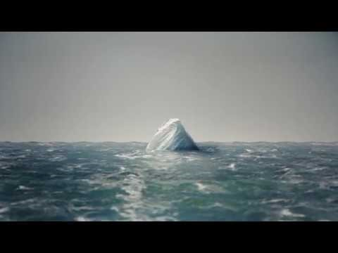
Campaign Examples: Planet or Plastic?
Notes:
Examples.
Ask these questions: What was their strategy? Where did they use the 'dos'? Where did they fall victim to the 'don'ts'?

Slide 20
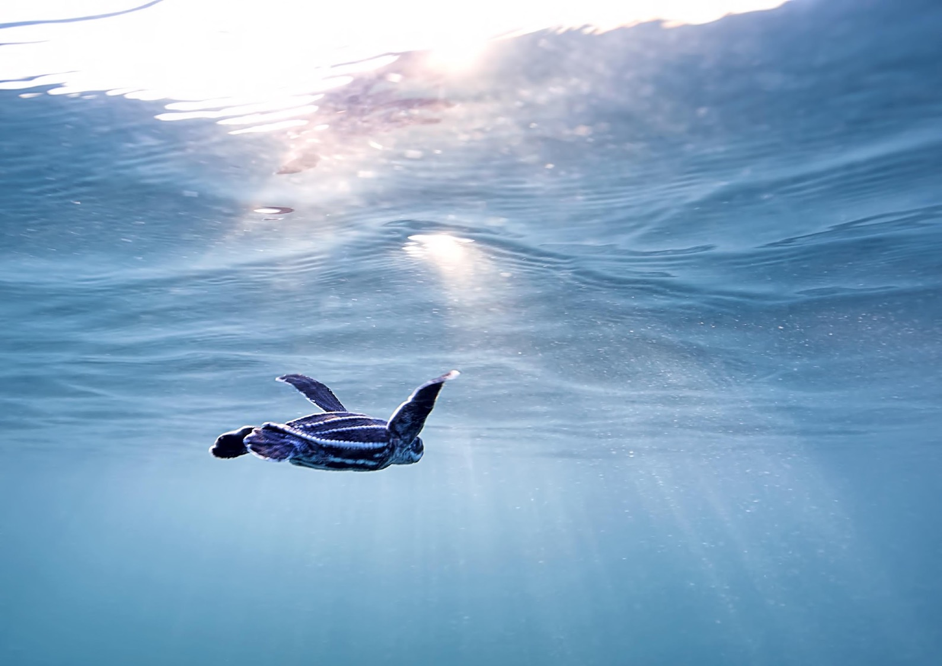
Examples of successful behavior change campaigns
These campaigns didn't stop at raising awareness!
They also prioritized identifying the motivation behind the undesirable behavior.

Slide 21
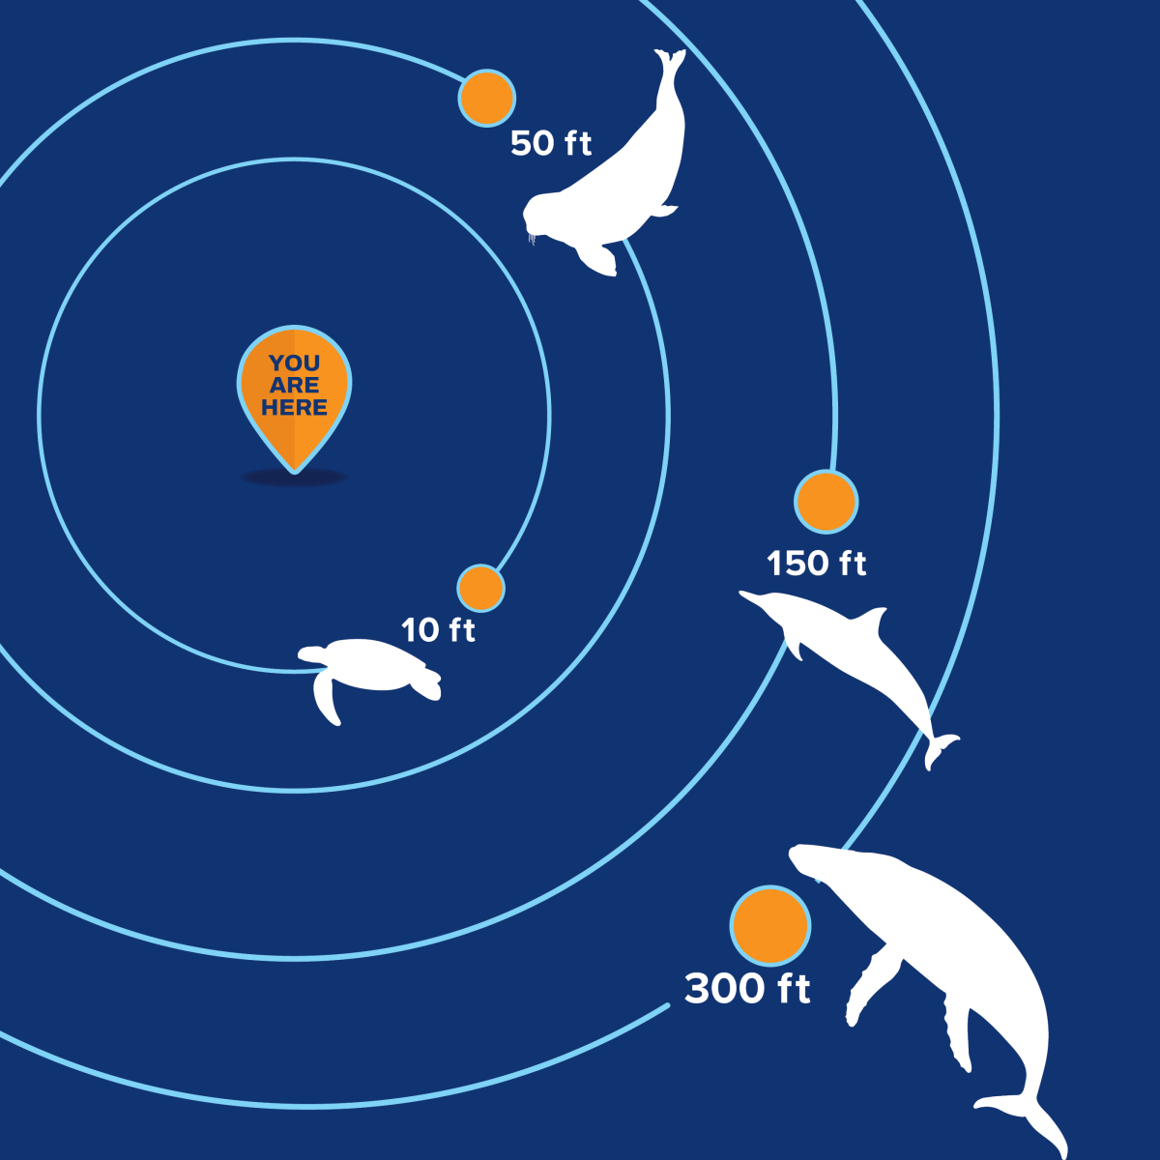
Goal: Encourage tourists in Hawaii to admire wildlife from a respectful distance
Through sharing the “why” and removing efficacy barriers, the group is effectively removing this threat for Hawaiian wildlife
“Join the pod of others like you who are Kind to Oceankind”

Slide 22
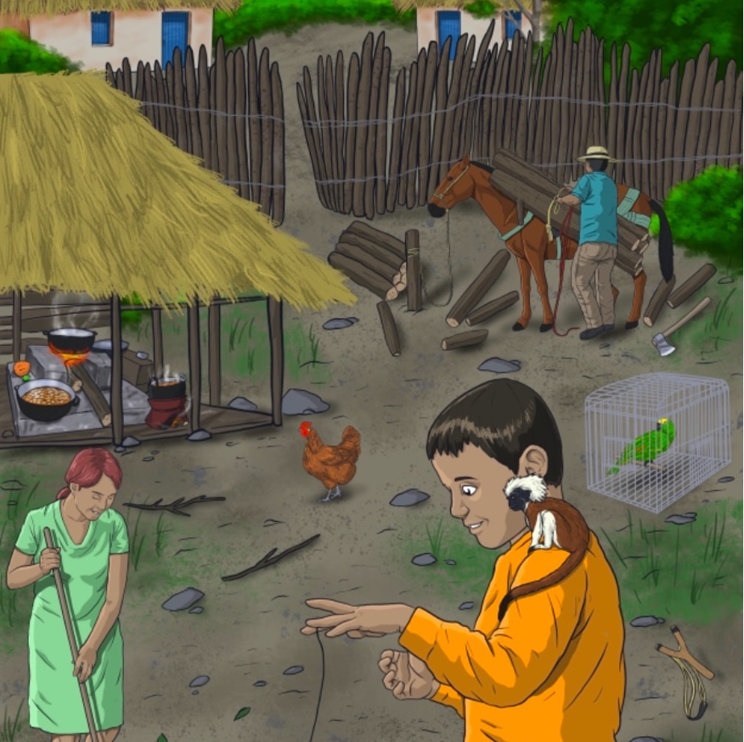
AMIGUAU
Goal: Reduce the desire of children to have cotton-top tamarins as pets
Early surveys indicated a desire to have dogs as pets; yet village dogs were not currently viewed as pets
5-week program: collaboration w/ Proyecto Titi and Disney animal keepers to teach dog training to kids & families in village
Evaluation included surveys for behavioral intention, long-term follow ups, and impact evaluation

Slide 23
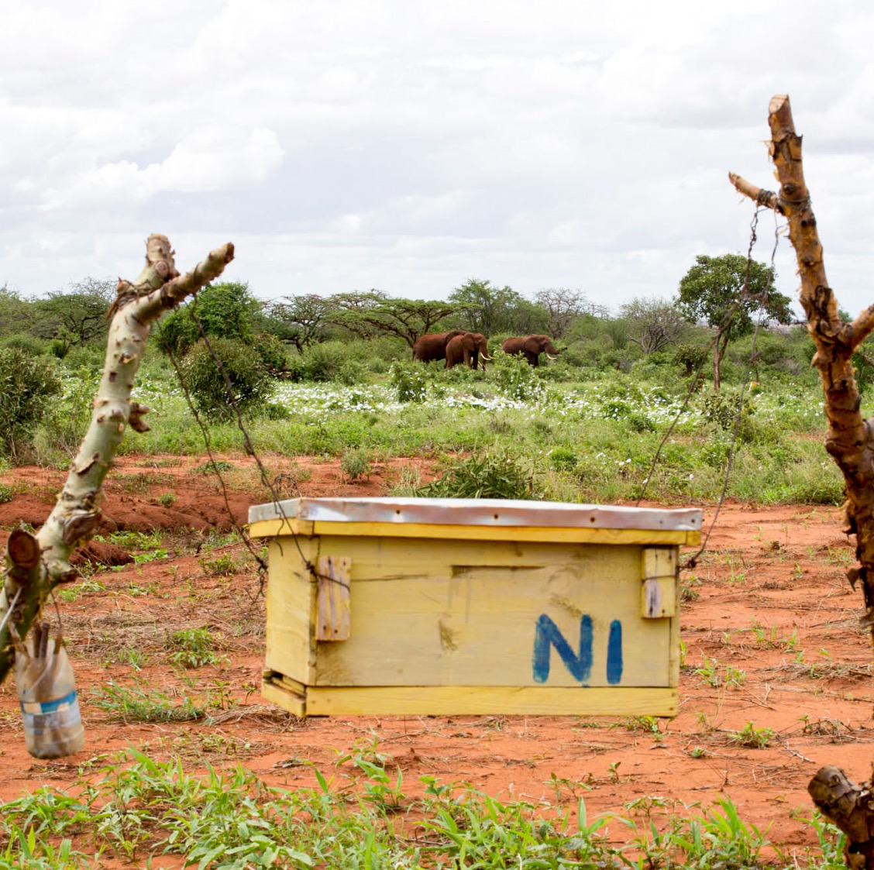
Goal: Prevent killing of crop-raiding elephants by farmers without impacting livelihoods
“A win-win addition to a toolbox of deterrent methods, beehive fences help create a social and economic boost to farmers through pollination services and the harvesting of ‘Elephant-Friendly Honey’”
Started in Kenya but now expanded to 17 countries including Asia

Slide 24
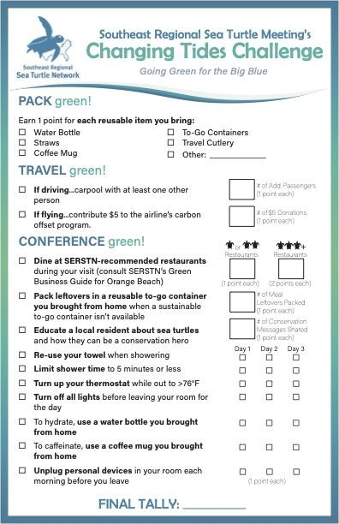
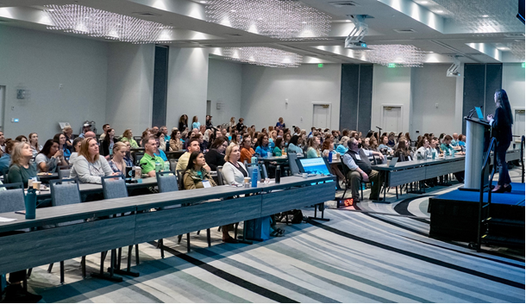
Changing Tides Eco-Challenge
Goal: Lower the eco-footprint of a scientific meeting

Slide 25
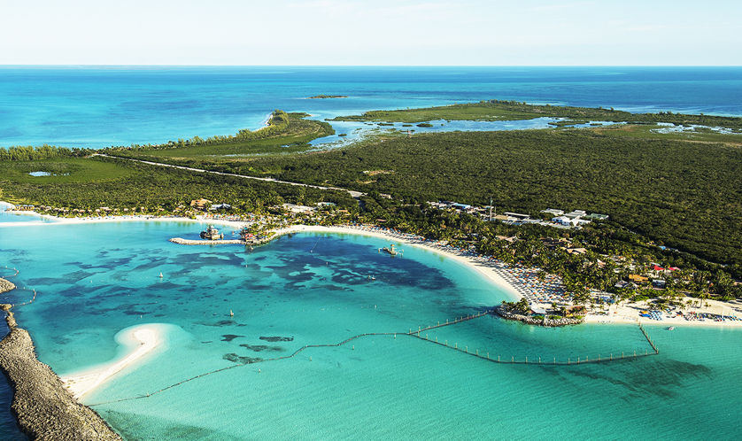
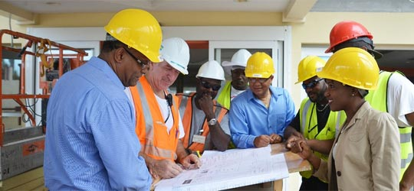
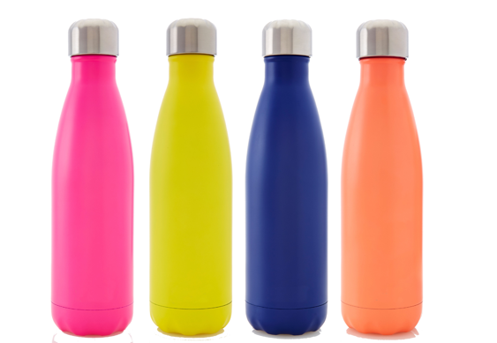
Learning Opportunities
Contractor Incentive Program

Slide 26
Learning Opportunities
Notes:
NOTES - will edit presentation style later)
In consultation with our Stanford partners, we have adapted our focus away from targeting and measuring individual behaviors (e.g. individual plastic use, etc.) toward targeting and measuring ocean conservation identity and community engagement. This shift better reflects the reality of human behavior—behaviors happen in the context of an identity, and are effective in the long-term when supported by a community.
In developing Blue Habits, the behavioral science research showed us that people perform habits and behaviors based on their personal identity and that identity is shaped by social relationships and the actions and habits demonstrated and observed in their own communities and places.
Therefore, social norms play a critical role in shaping individual behaviors; people are more likely to do things that they think and/or see other people are doing, especially those within our social circles or that we look up to.

Slide 27
Meet the 5 case studies

Slide 28
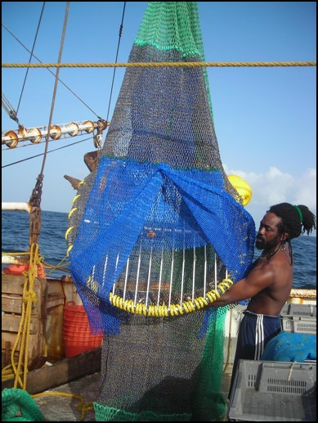
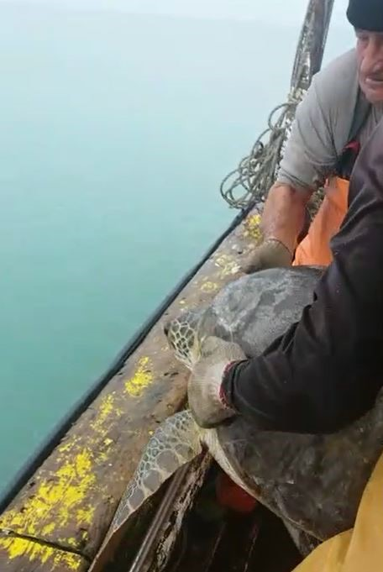
Case Study #1: Olive ridley bycatch in French Guiana

Slide 29
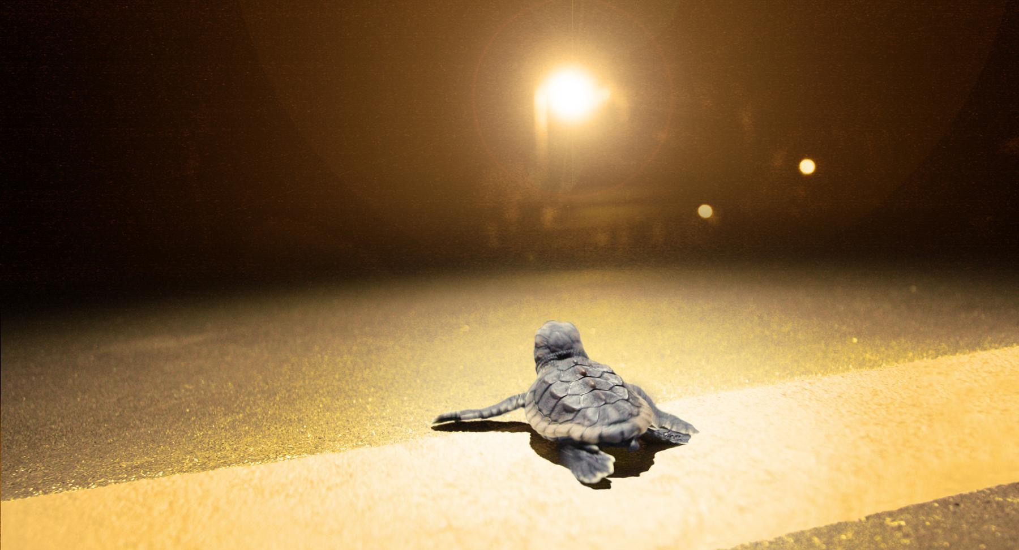
Case Study #2: Mitigating Light Pollution from Short-Term Rentals in Florida

Slide 30
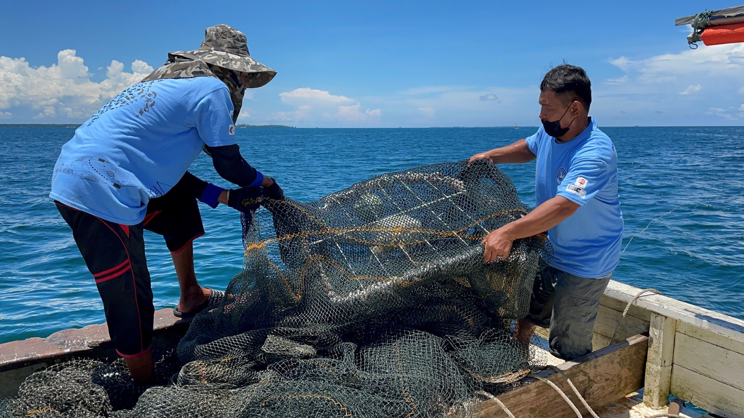
Case Study #3: TED Adoption in Sabah, Malaysia

Slide 31
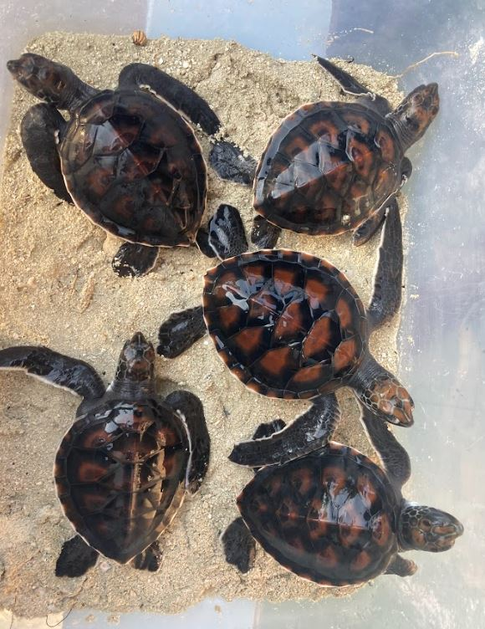
Case Study #4: Discouraging pet hatchlings
Maldives, Naifaru, Lhaviyani Atoll

Slide 32
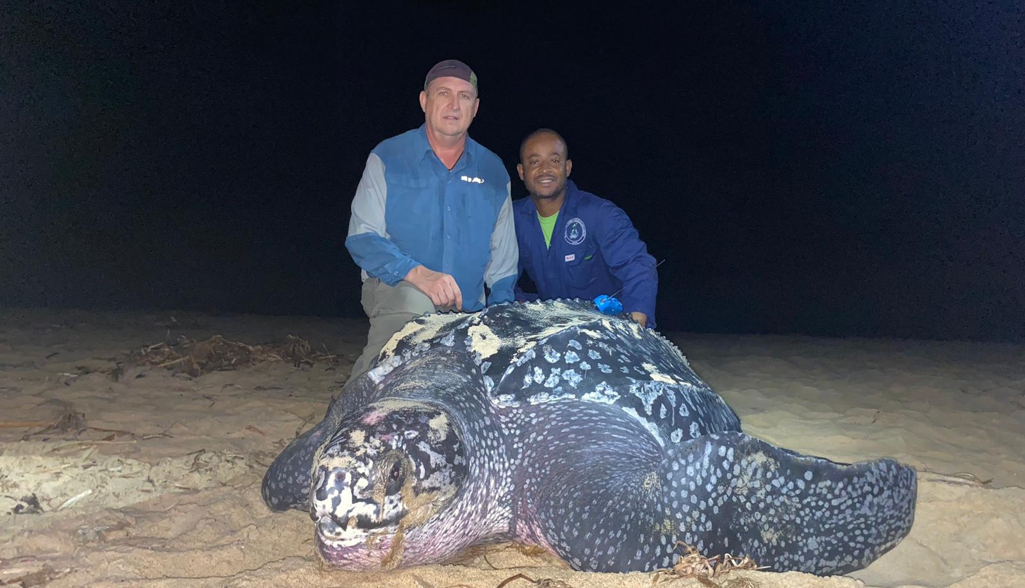
Case Study #5: Direct take of nesting leatherbacks & olive ridleys in Ghana

Slide 33
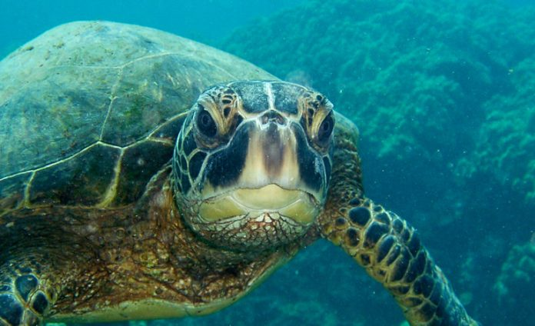
Breakout Groups
Read over your case description
Talk with your group about initial reactions
Identify a recorder and presenter for your group
We will work through the worksheet, step by step
Record final plan on a single worksheet to be handed in
We will spend about 20 minutes in breakout groups for each section of the worksheet.
Notes:
Add general note about expectations/process- how long will they be in breakouts?

Slide 34
Norms & Commitments
Be present and prepared to engage
All ideas are welcome and valued
Assume good intent
Recognize your ideas as representing your own, unique perspective
In plenary, please raise your hand to speak
Notes:
Interactive poll: How much do you currently know about creating behavior change campaigns?

Slide 35
Steps to create a behavior change strategy
Identify the threat or challenge
Identify behaviors to help mitigate the threat
What?
Identify your target audience
What do you know and not know about your target audience? What assumptions are you making?
Stakeholder analysis- who do you need on your team to successfully change this behavior?
Who?
Identify motivations for current behavior
Identify barriers to adopting the desired behavior
Why?
Identify potential theories/frameworks to help guide your strategy
Determine your key message and how you will frame it
Determine mode of delivery to best reach your audience and key spokespeople
How?
Consult the Team BEACH network when thinking through future campaigns!
Notes:
Not super linear- may need to jump around

